Slide 1

Palm Springs Housing Analysis
-Author-
Amber Paige Webber

Slide 2
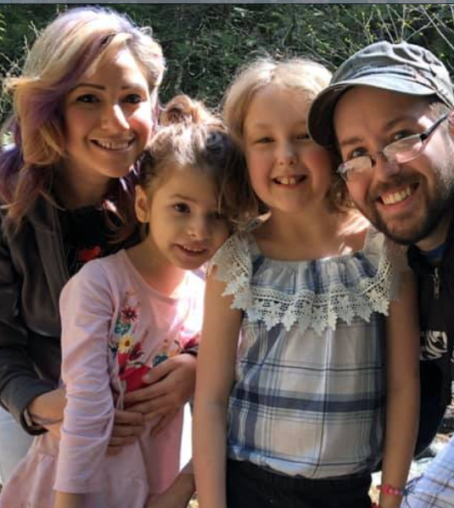
The Coopers
Family of 4
2 Cats: Loki & Bjorn (Asshole Cat 1 & Asshole Cat 2)
1 family car
Budget: $1.3 million
Housing Requirements:
3 Bedrooms
2 Bathrooms
Fenced Yard
Low Crime Area
Close to Schools

Slide 3
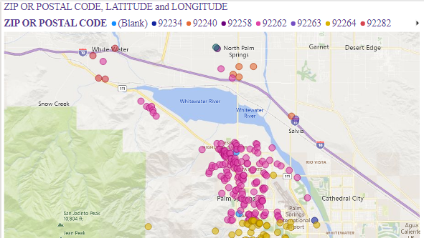
The Palm Springs region that the Coopers are looking to relocate their family to.

Slide 4
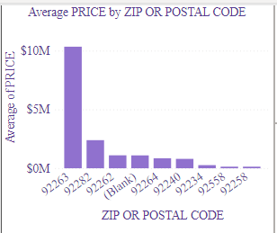
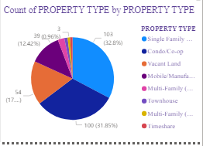
92262 & 92264 are within the budget and within low crime areas! Let’s dive into the details within those locations.

Slide 5
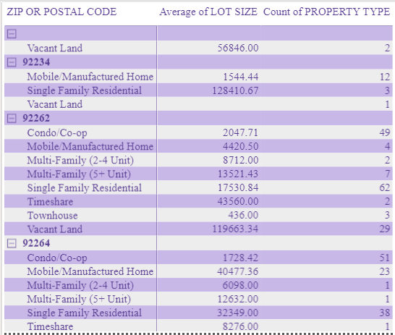
62 Single Family Residences in 92262
38 Single Family Residences in 92264
Quite a bit of options!

Slide 6
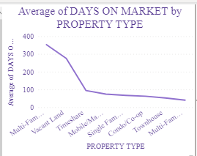
Single Family Residences are not on the market for very long. Suggesting we find a residence and close in on it sooner the better.
The following homes have only been on the market for 8 – 11 days and they will go fast!

Slide 7
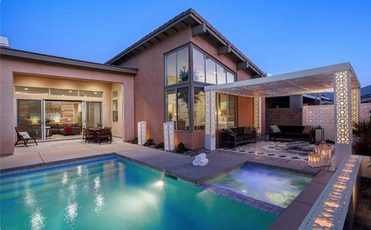
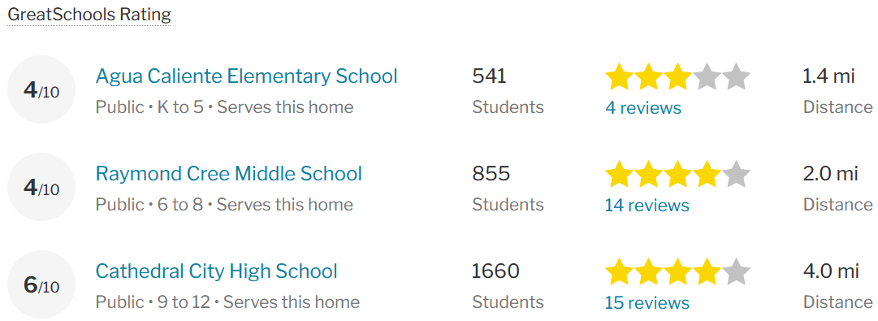
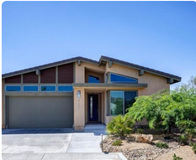
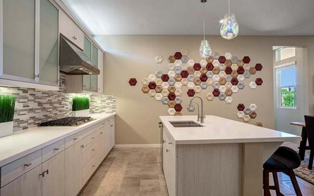
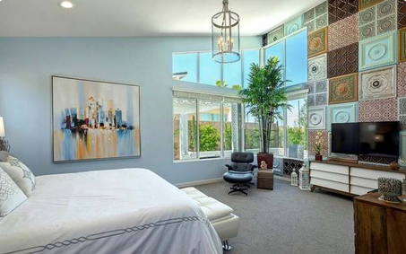

Slide 8
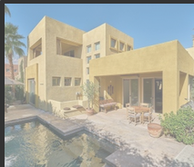
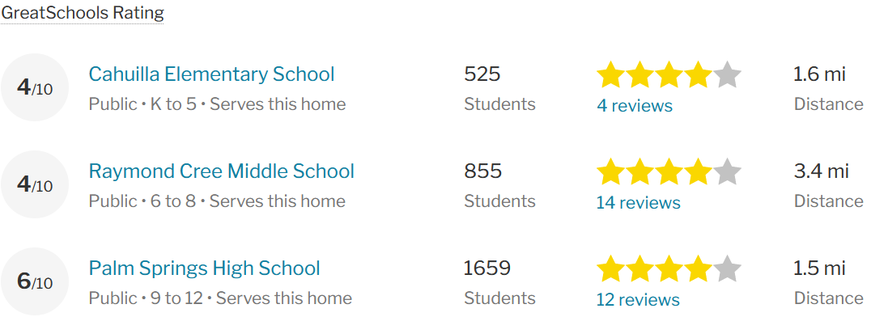
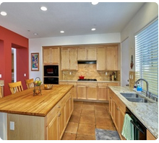
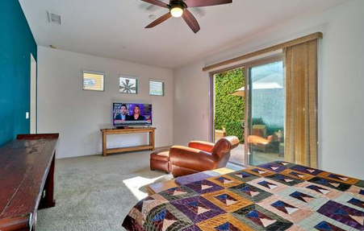
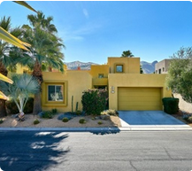

Slide 9
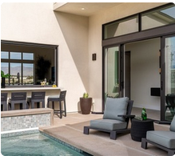
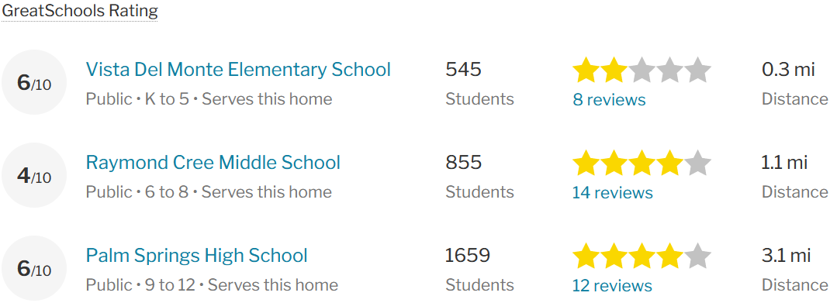
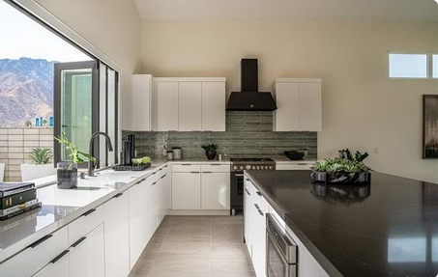
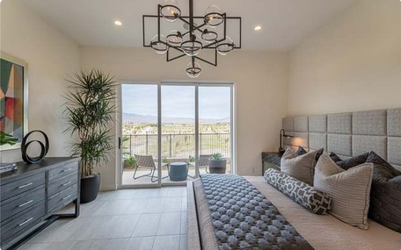
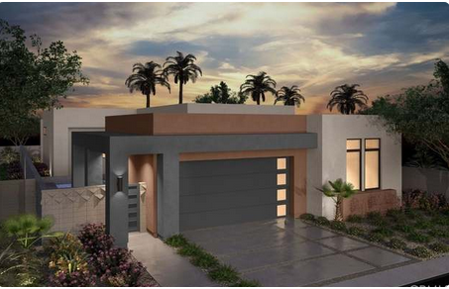

Slide 10
All three homes presented meet every criteria that the Coopers are requiring.
Most importantly these areas have low crime and are within the budget!
Options, options, options!
I’m suggesting that the 3rd option, at 725 N Fountain Drive, be one of prime interest. It’s a newly constructed home and it’s much cheaper than the budget which will allow more of the set aside budget for furnishings. We all know that Mrs. Cooper is all about interior decorating and this will enable her to have more freedom to make this home, “their” home.

Slide 11
HW #3 Feedback/Rubric Score: /20
Complete Requested Technical Work in Power BI: /10
Dashboard with pinned PivotCharts + additional content
At least 2 reports developed in Office 365 PowerBI
At least 2 reports developed in Power BI Desktop
HW#1 workbook or equivalent available via Excel Online
Professional Presentation and Analysis: /10
Client introduced
Presentation tells a story
Final recommendations supported by data and visualizations
Professional slides

